Slide 1

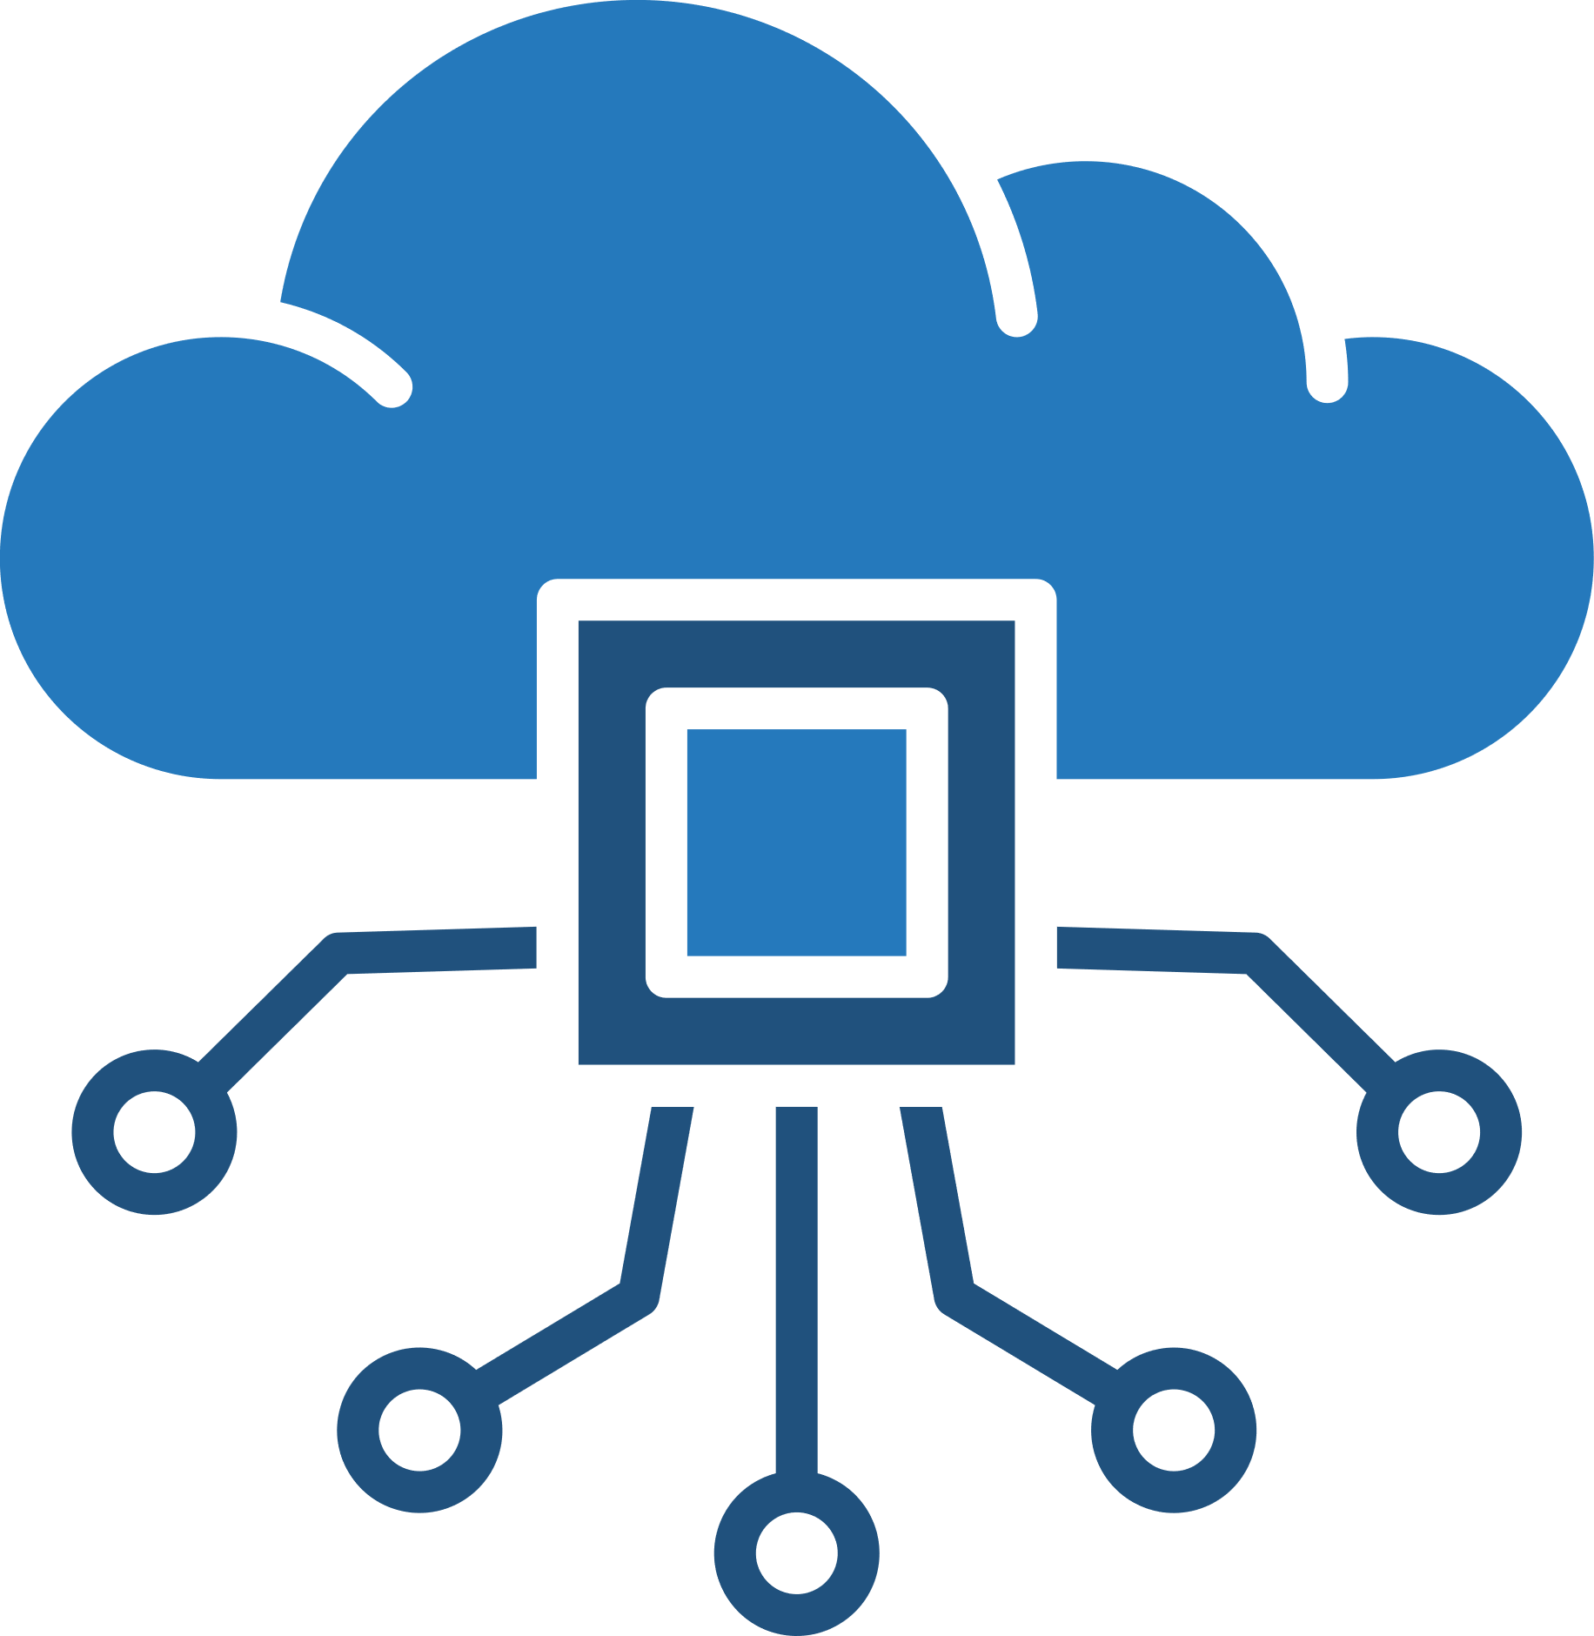
Edge Computing: Vision and Challenges
Presented By :
Authors: Weisong Shi, Jie Cao, Quan Zhang, Youhuizi Li, and Lanyu Xu
Institution: Wayne State University
Link: https://ieeexplore.ieee.org/abstract/document/7488250
Harsh Duggar - 31
Manaswi Kabadi - 40
Saniya Kadam - 41
Atharva Lotankar - 47

Slide 2










Table of Contents:
Definition & Why Edge Computing
Comparison: Edge vs. Cloud Computing
Case Studies – Cloud Offloading & Video Analytics
Case Studies – Smart Homes & Smart Cities
Case Study – Collaborative Edge
Challenges in Edge Computing
Opportunities & Future Prospects
Optimization Metrics
Conclusion & Future Directions

Slide 3
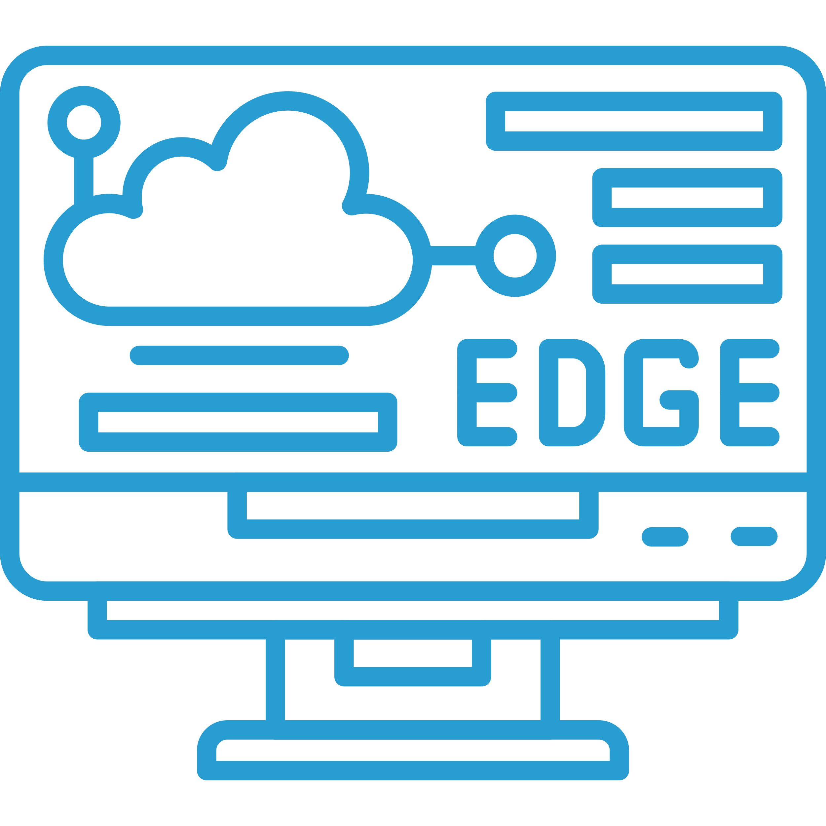
Definition & Why Edge Computing
Definition of Edge Computing:
Edge Computing refers to processing data near the source instead of relying on a centralized cloud.
Reduces latency, minimizes bandwidth usage, and improves real-time processing.
Edge devices include routers, gateways, micro data centers, and cloudlets.
Why Edge Computing?
Push from Cloud Services:
Data growth exceeds network capabilities.
Centralized cloud models cannot handle real-time needs efficiently.
Pull from IoT:
Billions of IoT devices generating massive data streams.
Need for local data processing to reduce response time.

Slide 4
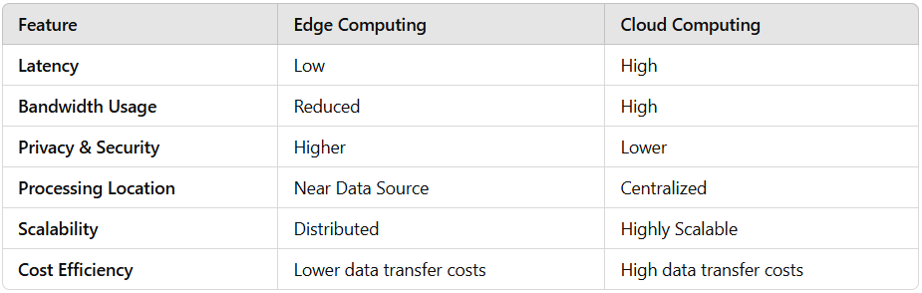
Comparison: Edge vs. Cloud Computing

Slide 5
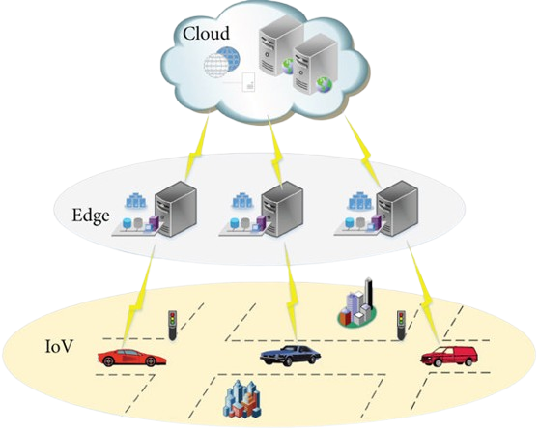
Cloud Offloading
Case Studies
Traditional cloud computing sends all data to a central hub, risking sluggish performance. Edge computing flips this, pushing tasks to nearby edge nodes to supercharge speed and delight users.
Advantages
Faster Response: Cuts wait times, a game-changer for mobile devices.
Smart Caching: Stores info and actions at the edge for quick access.
Enhanced Interaction: Fuels real-time tools like VR, gaming, and wellness apps with smooth operation.
Sync Hurdles: Switching between edge points can tangle data—research ahead!
USE CASES: E-Commerce, Wayfinding, Live Tech

Slide 6
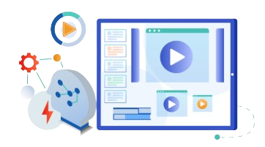
Video Analytics
Case Studies
Cloud computing stumbles with video due to slow uploads and privacy woes. Edge computing tackles this by analyzing video right where it’s captured, delivering speed and security.
Edge devices process video locally, skipping bulky cloud transfers.
Example: To find a lost child, city cameras scan footage on-site and send only results—not raw video—to the cloud, slashing time and sidestepping privacy issues.
Advantages: Lightning-fast responses for emergencies, reduced bandwidth use, and data stays local.
Challenges: Coordinating countless cameras and their data across edges.
USE CASES:
Safety, Entertainment, Surveillance

Slide 7
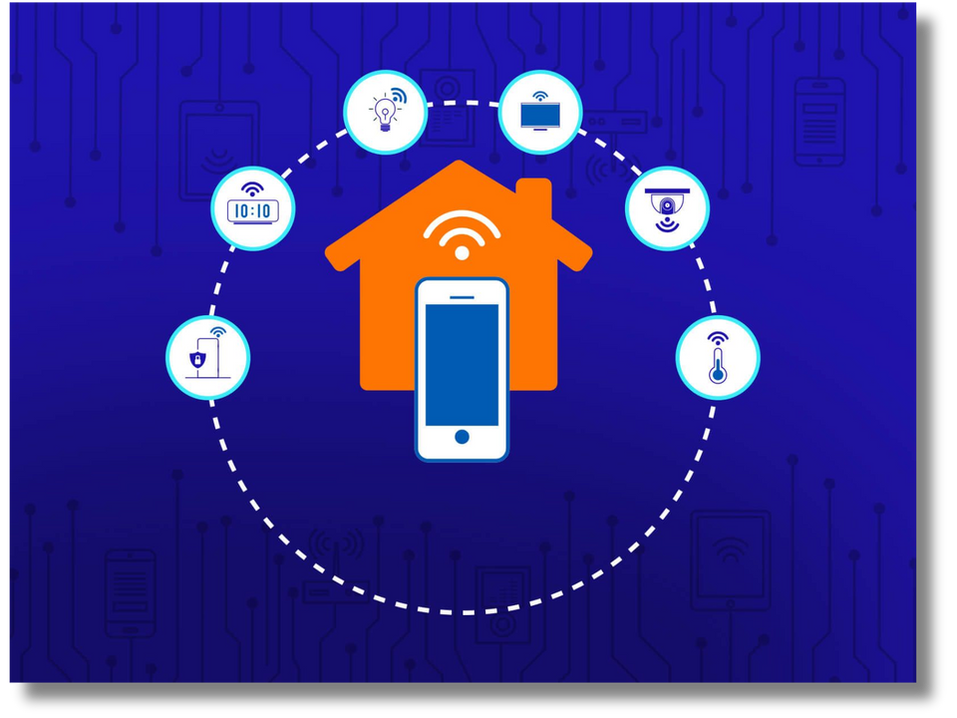
Smart Homes
Case Studies
Enhancing Automation and Urban Infrastructure with Edge Computing
Edge computing enables real-time processing of sensor data within homes.
Reduces internet bandwidth usage by processing data locally on an EdgeOS.
Enhances privacy by keeping personal data within the home.
Example: A smart thermostat adjusting temperature based on local sensor data instead of cloud-based commands.

Slide 8
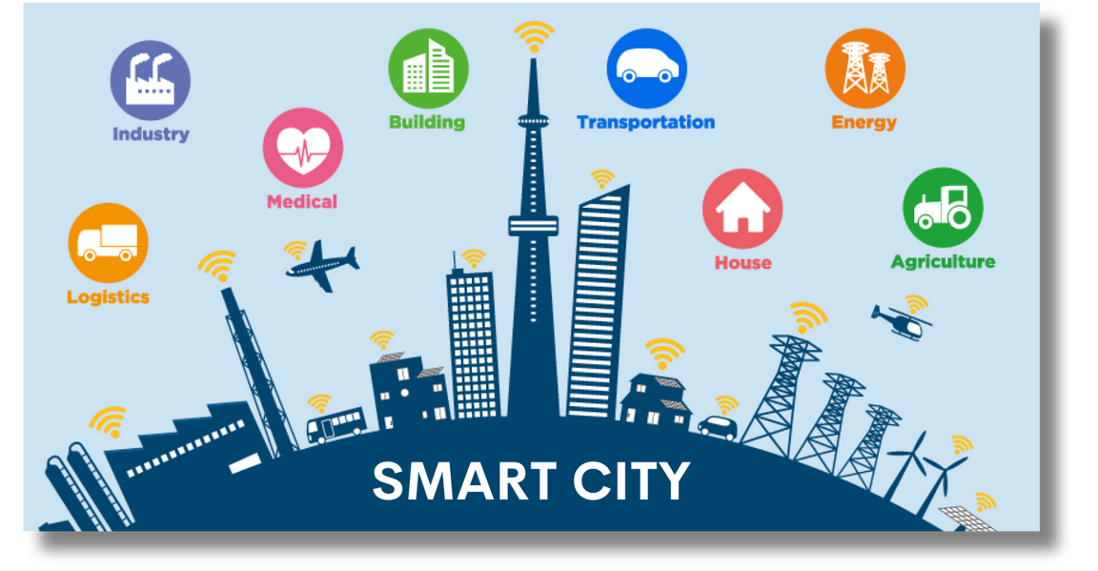
Smart Cities
Case Studies
Edge computing optimizes large-scale urban infrastructure like traffic lights, surveillance cameras, and public safety systems.
Processes data closer to the source, reducing latency for real-time applications like emergency response and transport systems.
Example: A missing person search using Edge-based cameras, where footage is analyzed locally, reducing cloud dependency.

Slide 9
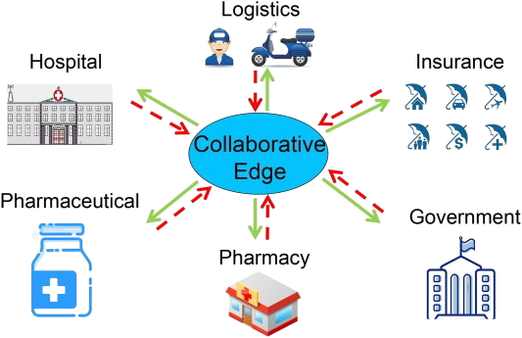
Collaborative Edge
Cloud Computing Challenges: Privacy concerns & high data transportation costs.
Edge Computing: Acts as a small data center, bridging cloud and end users.
Collaborative Edge: Enables data sharing & collaboration across locations.
Use Case: Connected Health (Flu Outbreak)
Hospitals: Update patient data in real time.
Pharmacies: Share flu-related purchase records.
Benefits: Improved healthcare accountability & efficiency.
Stakeholder Benefits
Pharmacies: Optimize inventory & maximize profits.
Pharmaceutical Companies: Adjust production & stock levels.
CDC: Track flu spread & issue timely alerts.
Insurance Companies: Modify policies based on outbreak trends & costs.

Slide 10
Challenges in Edge Computing
⚙️ Programmability
📊 Data Abstraction
Diverse hardware complicates development.
Apps must support different runtimes.
Managing diverse IoT data formats.
Balancing privacy with useful insights.
🔗 Service Management
🔒 Privacy & Security
Handling multiple IoT services (DEIR).
Ensuring reliability & scalability.
Protecting devices from cyber threats.
Ensuring secure data ownership.

Slide 11
Opportunities & Future Prospects
Opportunities
Reduced Latency: Faster response time for critical applications (e.g., real-time traffic management).
Bandwidth Optimization: Less data sent to the cloud, reducing congestion.
Energy Efficiency: Offloading processing to Edge devices improves battery life for IoT devices.
Future Research Areas
Collaborative Edge Computing: Interconnected Edge nodes sharing resources for better efficiency.
Data Privacy & Security: Developing frameworks to protect user data at the Edge level.
AI-Driven Edge Analytics: Deploying AI models directly on Edge devices for real-time decision-making.

Slide 12




Optimization Metrics
Workload Allocation in Edge Computing
Latency:
Process workloads at the nearest layer for faster response.
Example: Pre-process photos at the edge in smart cities to reduce upload time.
Bandwidth:
High bandwidth reduces transmission time, especially for large data.
Example: Smart homes process data locally to save bandwidth and improve reliability.
Energy:
Offloading tasks reduces energy consumption compared to local computation.
Example: Multi-hop transmission increases energy use, requiring optimal layer selection.
Cost:
Edge computing reduces latency, energy, and improves throughput, benefiting service providers.
Example: Cache popular videos at building-edge to free city-edge resources.
Providers may charge based on data location, balancing profit and user acceptance.

Slide 13
CONCLUSION
Edge Computing Momentum: Increasing shift from cloud to edge for faster, more efficient processing.
Enhanced Performance: Reduced latency, improved reliability, and optimized bandwidth usage.
IoT & Mobile Evolution: Transitioning from data consumers to both producers and consumers.
Smart Environment Advancements: Boosting efficiency in homes, cities, and beyond.
Collaborative Edge Advantage: Seamless integration between cloud and end users.
Bridging the Gap: Supports both traditional cloud computing and global data sharing.
Key Challenges & Opportunities: Focus on programmability, security, and optimization.
Future Outlook: Edge computing is a critical pillar of next-gen digital infrastructure.

Slide 14
THANK YOU

